Slide 1

Welcome to Nursery
Beech
Mrs Thomas
Be Your BEST
Believe – Excellence – Safe – Team

Slide 2
Staff
Teacher: Mrs Thomas
Year group support staff:
Mrs Hatchett
Miss Ward
Entrance/exit door: Green side gate/ Classroom door
Be Your BEST
Believe – Excellence – Safe – Team

Slide 3
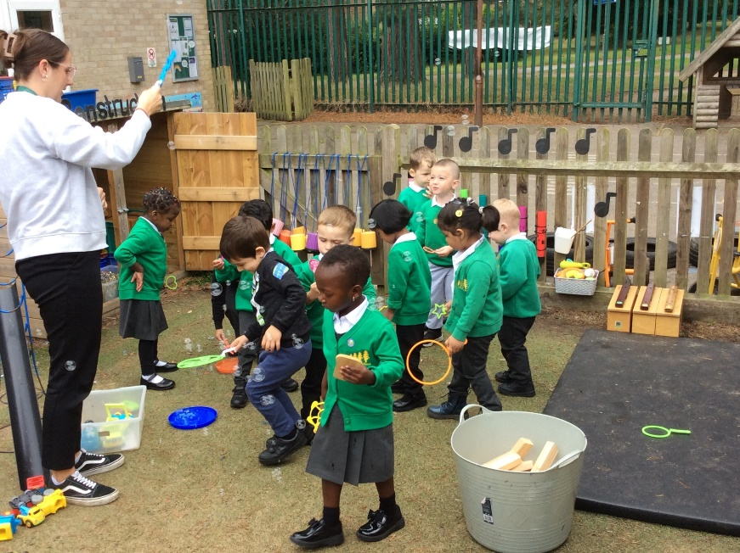
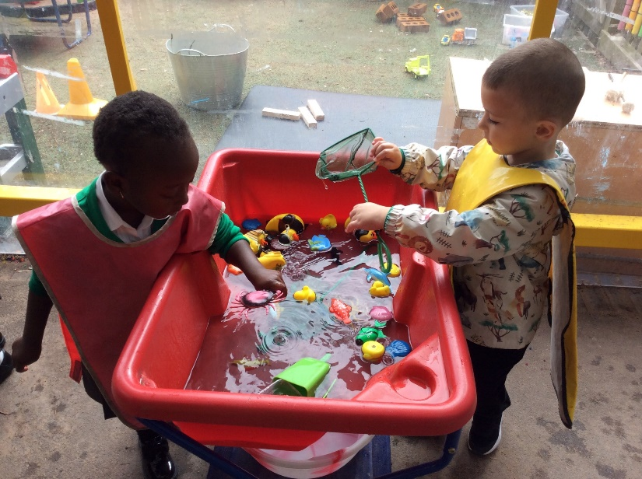
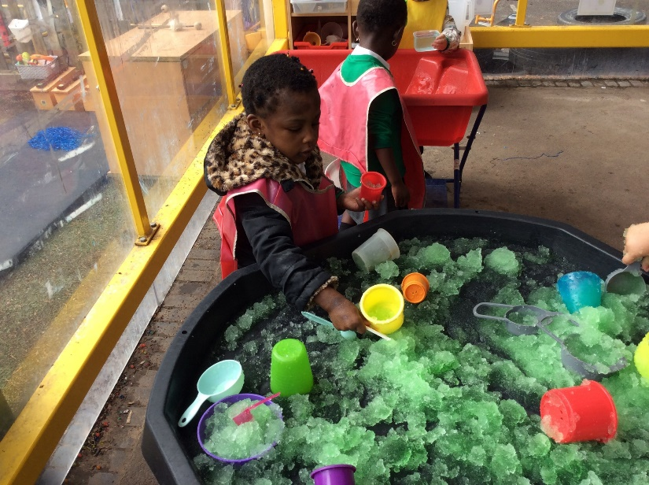
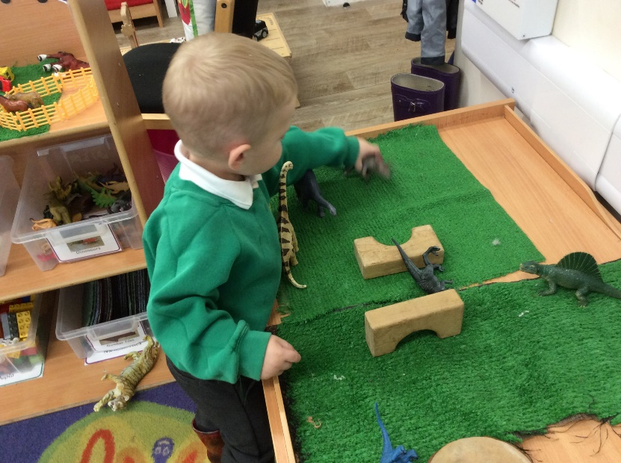
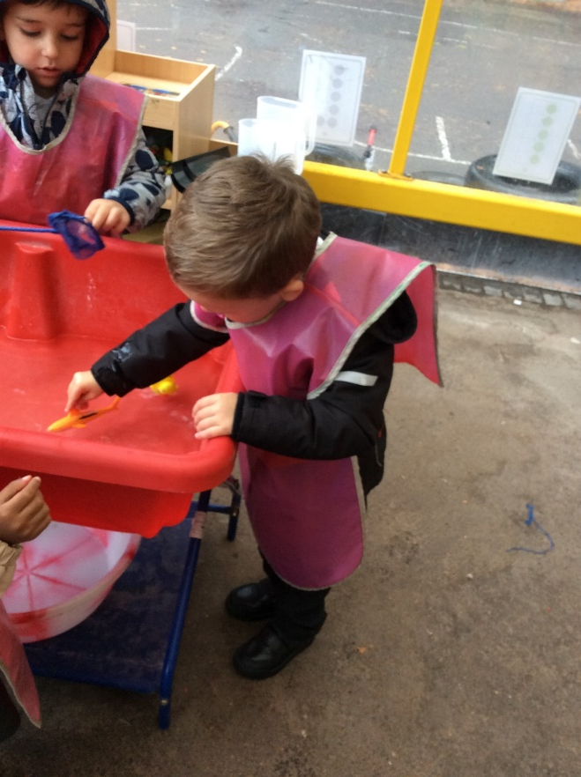
Welcome Back/ To School
Be Your BEST
Believe – Excellence – Safe – Team
Notes:
We have spent our first few days of this term establishing routines and developing relationships. The children have settled in beautifully and as there is a small number we are really able to spend time getting to know them.

Slide 4
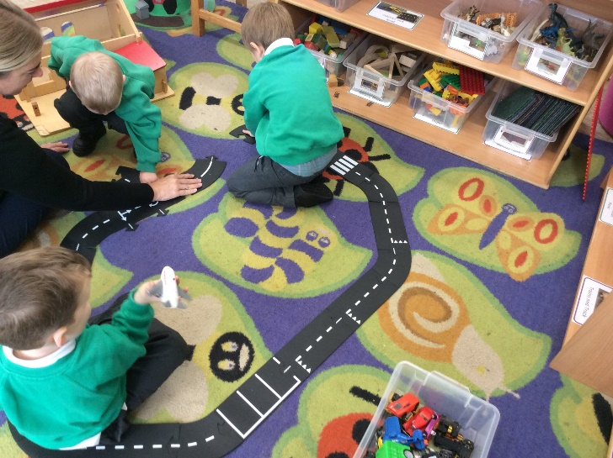
Learning in Nursery:
Early Years foundation stage framework
Prime Areas:
Communication and Language.
Personal Social and Emotional Development.
Physical Development.
Specific Areas:
Literacy.
Mathematics.
Understanding the World.
Expressive Arts and Design.
Be Your BEST
Believe – Excellence – Safe – Team

Slide 5
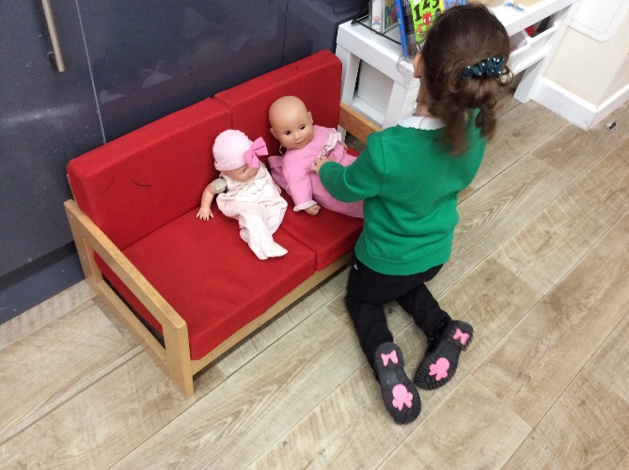
Learning in Nursery:
Group time:
Small groups of 7 children.
Complete the calendar.
Name recognition.
Rhyme of the week.
Short activity linked to one of our areas of the curriculum.
Continuous provision:
The resources in the classroom and outside space that the children access support their learning.
Adult support the children in their play to further their learning. Demonstrating skills, asking questions, building language.
Be Your BEST
Believe – Excellence – Safe – Team

Slide 6
In the moment planning/ Seesaw
Once a term your child will be a focus child. During this week we will record some of their learning moments that happen in their play and group time. We will also send home a letter asking for some information about what your child is enjoying at home and any achievements.
The learning moments that we record will then be sent to you as a paper copy and via seesaw.
We will also send photo of other moments in Nursery such as Sports Day via Seesaw.
Be Your BEST
Believe – Excellence – Safe – Team

Slide 7
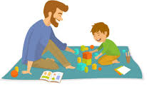
How you can support your child in Nursery
Maths: Recognising numerals and counting to 10.
PSED: Encourage your child to be independent with things like eating, toileting, and getting dressed. Literacy: Share stories with your children. Talk about what parts they like and look a the pictures.
Be Your BEST
Believe – Excellence – Safe – Team

Slide 8

Children who read for 20 minutes per day are exposed to 1.8 million words per year!
Be Your BEST
Believe – Excellence – Safe – Team

Slide 9

Snacks
Water bottles should come to school everyday. Please name them!
Fruit/ Vegetables and milk and water are provided on our snack table. The children can access this throughout the day.
Be Your BEST
Believe – Excellence – Safe – Team

Slide 10

Lunches
Lunches are eaten in the classroom. Hot lunches are brought down from the lunch hall by a member of staff.
Packed lunches should reflect our aim to be a healthy school
We do not allow sweets/chocolates or fizzy drinks.
We are a NUT FREE school (including peanut butter, Nutella etc) due to children with severe allergies.
Hot lunches are ordered through the schools gateway app. If you need any help with this please ask!
There is an additional cost for hot lunches.
Be Your BEST
Believe – Excellence – Safe – Team

Slide 11

What your child needs at Nursery
Water bottle.
Lunch box (if having a packed lunch).
Bag.
Coat.
Wellies (we go out all in all weathers!).
Sunhat/ winter hat, gloves etc (depending on the weather).
Please make sure everything is named!
Be Your BEST
Believe – Excellence – Safe – Team

Slide 12

Communication
Sign up for emails from The Pines at the Office
Headteacher’s newsletter each Friday
Nursery newsletter each Monday
Termly curriculum newsletter
Website: www.thepinesschool.org.uk especially our class webpage
X: @thepinesprimary
Email: Please e-mail the office for urgent communication and they will send to the relevant people.
beech@thepinesschool.org.uk
Be Your BEST
Believe – Excellence – Safe – Team

Slide 13
Attendance
Attendance at school is really important. Of course, children will occasionally be unwell and need time off school but please aim for your child to be in school every day. Odd days of absence really disrupt a child’s learning and can make it difficult for them to catch up. If you need to take your child out of school for an unavoidable appointment, please contact the school office.
Be Your BEST
Believe – Excellence – Safe – Team

Slide 14
Pupil Premium
If you receive Benefits, your child may be entitled to Pupil Premium funding. This benefits both your child and the school. The funding can be used in a variety of ways and could include paying for additional learning support, contributing towards the cost of activities, providing extra resources etc.
If you would like further information, please speak to a member of staff.
Be Your BEST
Believe – Excellence – Safe – Team

Slide 15
Managing Medications in school
We have a new 'Managing Medications in Schools Policy'. This is a Local Authority policy that we have adopted. Please note there are a few changes to be aware of:-
Parents/carers are encouraged to request GPs and other prescribers to prescribe antibiotics to be taken at frequencies that will eliminate the need for them to be given during the school hours where possible. It should normally only be necessary to administer antibiotics in school if the dose needs to be given four times a day, in which case a dose is needed at lunchtime. Antibiotics should always be administered in accordance with the prescriber’s instructions.
Pupils under the age of 16 years should not be given aspirin, ibuprofen or codeine, or any medicines containing these medicines unless prescribed by a doctor. We have had a few cases in the past when we have had ibuprofen for migraines, broken bones etc. From now on we would only be able to accept paracetamol.
Be Your BEST
Believe – Excellence – Safe – Team

Slide 16
Our Vision Statement:
We are a vibrant school where everyone is challenged to be their best.
Be Your BEST
Believe – Excellence – Safe – Team

Slide 17




Be Your BEST
Here at The Pines we strive to be the best version of ourselves.
Believe
Excellence
Safe
Team
These are our values!
Be Your BEST
Believe – Excellence – Safe – Team

Slide 18




Believe: We are a community who inspire all to believe in themselves and hold courageous aspirations.
Excellence: Through a fun and engaging curriculum we develop the skills to excel as lifelong learners.
Safe: We take responsibility for the safety of ourselves, others and the environment.
Team: We nurture a culture of respect, kindness and collaboration so that we can be the best team.
Be Your BEST
Believe – Excellence – Safe – Team

Slide 19

Behaviour – Be Your BEST
We set the boundaries and model behaviour. E.g. teaching a child how to ask for a turn with a toy, or to ask for help from an adult.
We praise good behaviour. E.g. good sitting and listening or nice sharing with friends.
Redirect behaviour. E.g. throwing a toy, we show them how to use the toy or where the balls or beanbags are that they can throw.
Be Your BEST
Believe – Excellence – Safe – Team

