Slide 1
AUTUMN

Slide 2

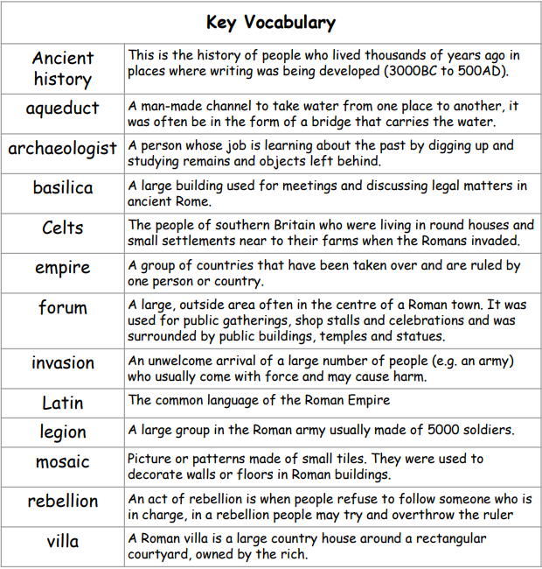
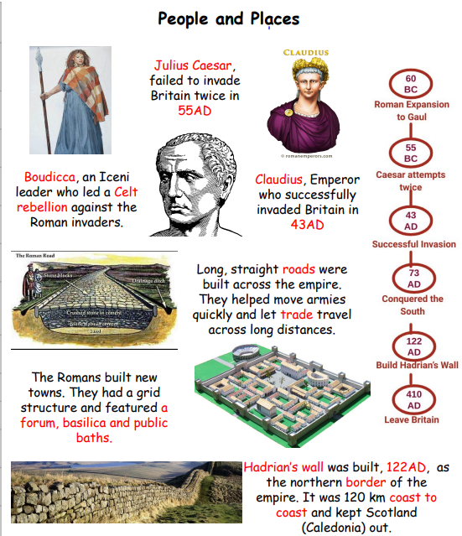
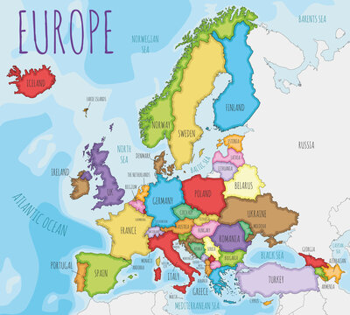
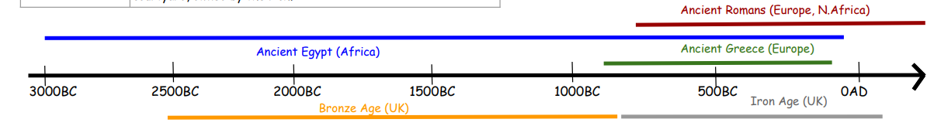
Ancient Romans
Year 4
Key vocabulary
Does power make people more successful?
Word | Definition
Key learnings:
Understand the Roman Empire and its impact on Britain
Identify a local history study
Understand geographical similarities and differences through the study of human and physical geography of a region of the UK and a region of a European country (Italy)
Locate countries across the world map

Slide 3
SPRING

Slide 4
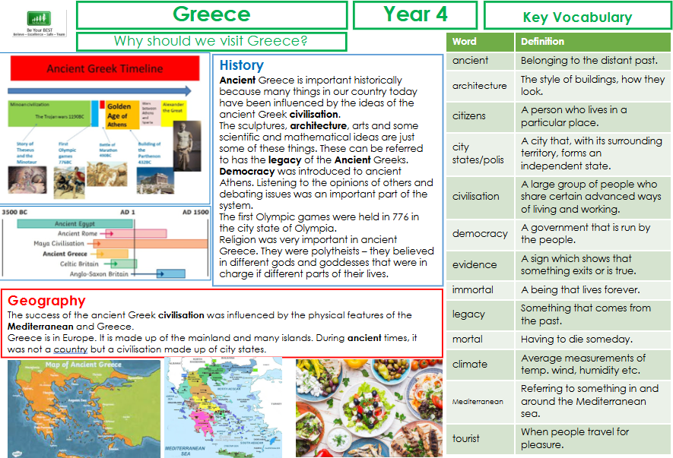

Slide 5
SUMMER

Slide 6


